Slide 1
CS5551 Advanced Software Engineering
Cloud Computing
Sources: AASCIF IT Committee, Emerging Technologies, Cloud Computing, Software as a Service
Mark Baker, Cloud Computing

Slide 2
What is Cloud Computing?
Simply stated: Cloud = Internet
So…Cloud Computing = Internet-based Computing
More precisely, Cloud computing is:
using information technology as a service.
having services that are available over a network.
using encapsulated services that have an API.
adding to the efficiency for deploying applications.
billing by consumption.
Notes:
Brian’s theory of relativity is the equation that the Cloud is equal to the Internet.
The definition really encompasses what cloud computing means for all cloud service models.
The purest in us would want all these to apply, but the most general interpretation is that if it is on the other side of the firewall, it is in the cloud.

Slide 3
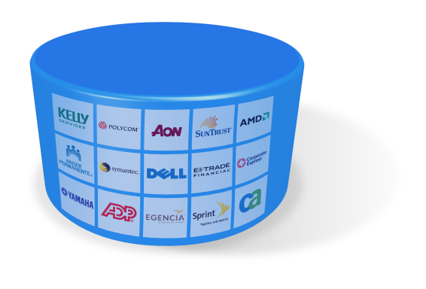
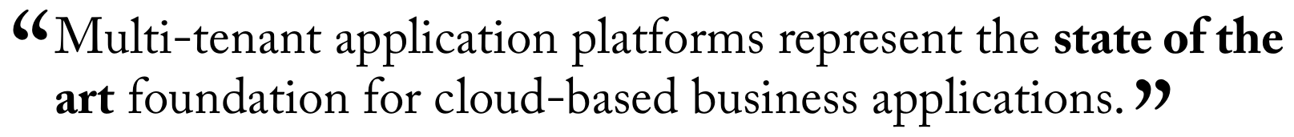

The Cloud Computing Model
Multi-tenancy refers to a principle in software architecture where a single instance of the software runs on a server, serving multiple client organizations (tenants).
contrasted with a multi-instance architecture where separate software instances (or hardware systems) are set up for different client organizations.
a software application is designed to virtually partition its data and configuration, and each client organization works with a customized virtual application instance.
Multi-tenant
Pay-as-you-go
Elastic
No Capital Expense
Modest Operating Expense
Scales With Your Business
Yefim Natis, VP, Distinguished Analyst
Notes:
3

Slide 4
Cloud Service Models
Solutions range in category from coarse to fine grained, with the potential for coarse-grained solutions to be made up of fine-grained resources.
*Software as a Service (SaaS)
*Platform as a Service (PaaS)
*Infrastructure as a Service (IaaS)
Storage as a Service (SaaS)
Database as a Service (DaaS)
Notes:
Software as a Service: Cloud based delivery of complete software applications that run on infrastructure the SaaS vendor manages. SaaS applications are accessed over the Internet and typically charged on a subscription basis.
Platform as a Service: Delivery of a virtualized application runtime platform that has a software stack for developing applications or application services. PaaS applications and infrastructure are run and managed by the services vendor.
Infrastructure as a Service: Delivery of raw, virtualized computing infrastructure such as servers and storage as a service to build applications. IaaS vendors let enterprises customize infrastructure to their application needs.
All the services loosely translate into purchasing a service that is accessed via the Internet.
Supposedly minimal configuration and setup is needed onsite.
Add the other services (Testing as a Service, Governence as a Service, etc.)
Configuration will always have to be done regarding security and access.
Some companies go as far as requiring dedicated lines to their offices in order to cover SLAs.

Slide 5
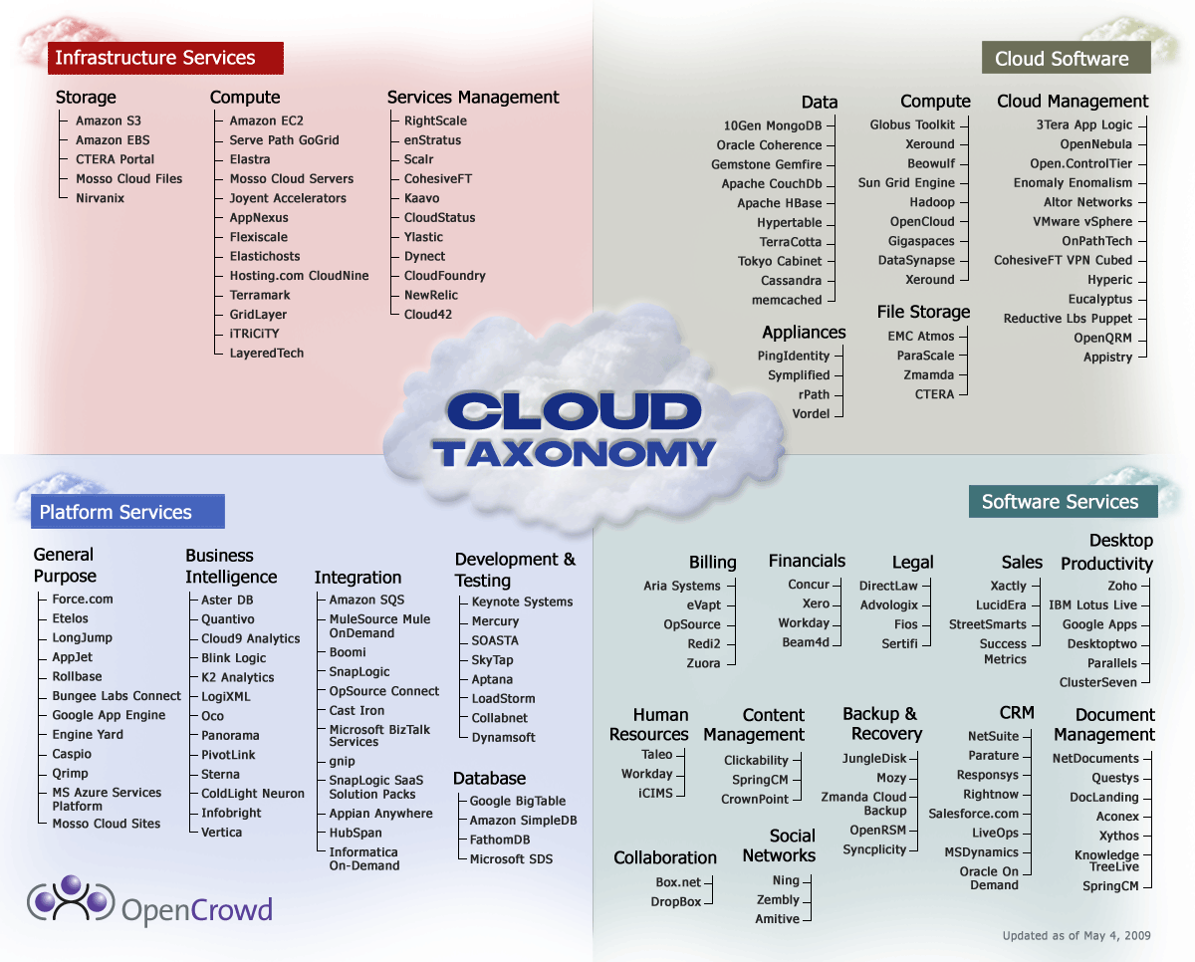
Cloud Taxonomy
http://www.opencrowd.com/assets/images/views/views_cloud-tax-lrg.png
Notes:
http://www.opencrowd.com/assets/images/views/views_cloud-tax-lrg.png

Slide 6
Cloud Offerings by Service
Software as a Service (SaaS)
Facebook, SalesForce.com, Gmail
Platform as a Service (PaaS)
Google App Engine, Microsoft Azure, IBM Bluemix
Infrastructure as a Service (IaaS)
3Tier, Amazon EC2, Rackspace, GoGRID
More
Structured
Less
Control
Less
Structured
More
Control
Notes:
An example of what is being offered by the type of cloud service.
http://smb-cloud.ulitzer.com/node/1514488
Software as a Service (SaaS) e.g. Facebook, Salesforce.com, applications running on a cloud infrastructure that can be accessed via a web browser interface.
Platform as a Service (PaaS) this goes back to the early 70's when it was referred to as Framework as a Service. What is does is simply to provide different combinations of services to a subscriber supporting an application development life-cycle e.g. Google's App Engine which will let a subscriber run web applications on Google's infrastructure or Azure. In essence the subscriber will use programming(.Net Java python) and tools supplied by the service provider with no underlying responsibility for the cloud deployed network, severs, operating system and storage etc. Infrastructure as a Service (IaaS) e.g. Tier 3, Amazon EC2,while the subscriber does not control the cloud infrastructure they do have control over select portions of network e.g. firewalls, operating system, deployed applications and storage.

Slide 7
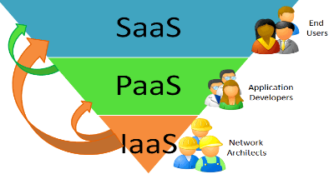
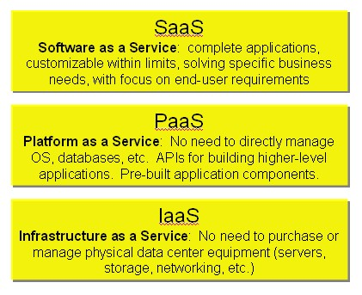
Cloud Taxonomy
Source: http://www.ingurus.com/cloud-tsunami-saas-paas-iaas-private-public-and-hybrid-clouds-theres-one-for-everyone/

Slide 8
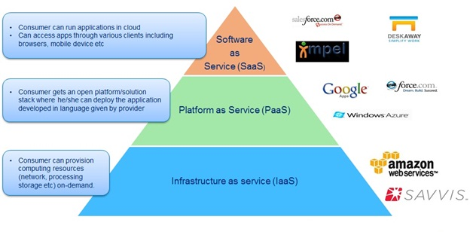
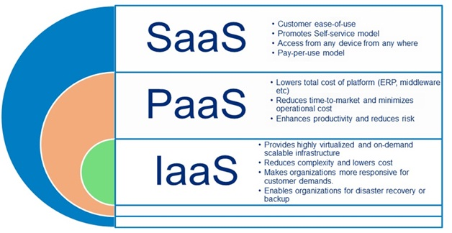
Cloud: Service Model
Source: http://www.infosysblogs.com/thought-floor/2012/02/c

Slide 9
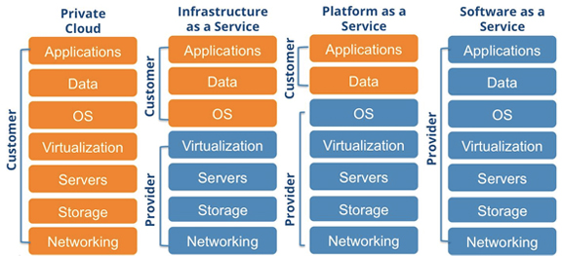
IaaS, PaaS, SaaS and Private Cloud
Source: https://www.sevone.com/solutions/hybrid-cloud-infrastructure-monitoring

Slide 10
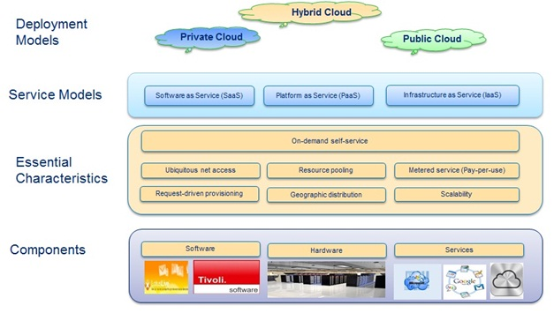
Source: http://www.infosysblogs.com/thought-floor/2012/02/c

Slide 11
Virtualization
Virtual workspaces:
An abstraction of an execution environment that can be made dynamically available to authorized clients by using well-defined protocols,
Resource quota (e.g. CPU, memory share),
Software configuration (e.g. O/S, provided services).
Implement on Virtual Machines (VMs):
Abstraction of a physical host machine,
Hypervisor intercepts and emulates instructions from VMs, and allows management of VMs,
VMWare, Xen, etc.
Provide infrastructure API:
Plug-ins to hardware/support structures
A hypervisor or virtual machine monitor (VMM) is a piece of computer software, firmware or hardware that creates and runs virtual machines.
App
App
App
OS
OS
OS
Hypervisor
Hardware
Virtualized Stack

Slide 12
Virtual Machines
VM technology allows multiple virtual machines to run on a single physical machine.
App
App
App
App
App
Xen
Guest OS
(Linux)
Guest OS
(NetBSD)
Guest OS
(Windows)
VMWare
VM
VM
VM
Virtual Machine Monitor (VMM) / Hypervisor
UML
Denali
Hardware
etc.
Performance: Para-virtualization (e.g. Xen) is very close to raw physical performance!

Slide 13
Virtualization in General
Advantages of virtual machines:
Run operating systems where the physical hardware is unavailable,
Easier to create new machines, backup machines, etc.,
Software testing using “clean” installs of operating systems and software,
Emulate more machines than are physically available,
Timeshare lightly loaded systems on one host,
Debug problems (suspend and resume the problem machine),
Easy migration of virtual machines (shutdown needed or not).
Run legacy systems!

Slide 14
Virtualization in General
Disadvantages of virtual machines:
Virtual machine is not as efficient as a real one when accessing the hardware;
When multiple virtual machines are simultaneously running on a host computer, each virtual machine may introduce an unstable performance, which depends on the workload on the system by other running virtual machines.
For many organizations, virtual computing doesn't cut costs or the need for IT staff.
Fair Pricing? running several different applications of the same software simultaneously. Meter process would provide users a specific amount of uses and charge them for any overages.

Slide 15
Cloud Delivery Models
Private
Uses cloud technologies to expose services across a private enterprise.
Public
All information access is housed in the public domain.
Hybrid
A combination of public and private services.
Notes:
Think of these as being similar to vehicles for travel. One can own his/her own car, plane or mobile home, someone else can own them and you would rent them, or there could be shared ownership.
http://smb-cloud.ulitzer.com/node/1514488
Private Cloud aka a corporate cloud refers to proprietary computing architecture providing hosted services to a limited number of people which resides behind a corporate firewall, in other words a single tenant. By using private clouds enterprises/tenants will receive the same economies of scale and bi-directional scaling as that of the public cloud user. However being a single enterprise or division within that enterprise will ensure the additional benefit of more control and security for data held within the private cloud, as on-premise data centers can be converted into private clouds by implementing virtualization technologies from companies such as Microsoft,Citrix, VMware, Novell and Sun. 2) Public Cloud is the cloud that is provided for lease external to an entity's physical location e.g. Amazon's EC2. This deployment facilitates rapid scaling via virtualization technologies (which enables cloud user resources an ability to rapidly start up and shut down,)and can be utilized by multiple tenants however, within this deployment users have no access to dedicated resources. This results in users giving up a certain amount of control over the process, which in turn can raise security and compliance issues. 3) Hybrid Cloud is a mixture of the public and private. This can be appealing for a company that chose to store non confidential data externally say using Simple Storage Service (S3) whilst keeping private data in-house.

Slide 16
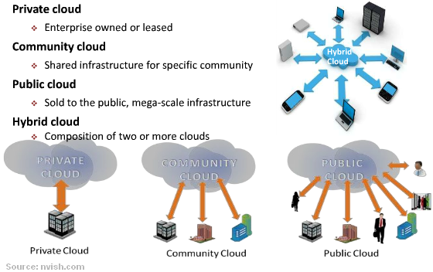
Cloud Delivery Models

Slide 17
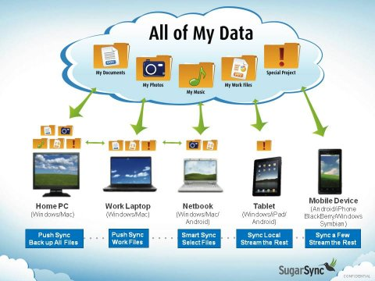
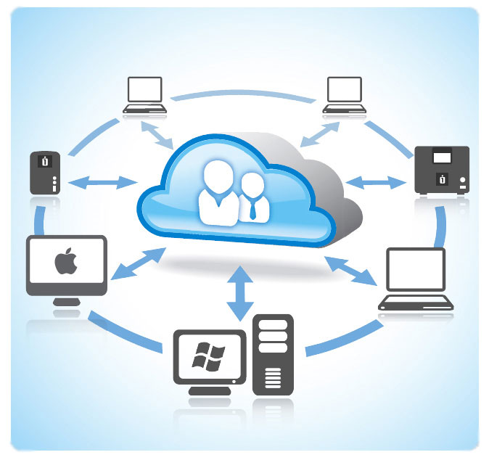
Personal Cloud
Video: http://www.youtube.com/watch?v=Cte_3v1dmNw
10 best storage services
http://www.thetop10bestonlinebackup.com/cloud-storage
Source: http://www.thecloudist.com/?p=984

Slide 18
Cloud Concerns/Issues
Security - #1 concern
Availability (mission critical vs. not)
Compliance
Price
Training
User Experience (UI design, Speed)
Data Ownership
Notes:
Security: This is the #1 concern. Companies like Google and Amazon have already addressed this through architecture design.
Availability: Vendors may suggest dedicated line to cloud service.
Compliance: Do you have the need for SAS 70 or PCI compliance?
Price: Is there a cost per hour or a monthly fee and how will it impact the SLA?
Training: What will IT have to learn in order to support the environment?
User Experience: Is there a new UI for the users to learn and what is the speed/response?
Data Ownership: Who owns the data (during and after the contract)?

Slide 19
Some Cloud Myths
One single “Cloud”
All that is needed is a credit card
Reduces workload
Seamless integration (datacenter to public)
Always saves money
Provider can guarantee security
Notes:
InfoWorld Article: Cloud Computing Deep Dive, September 2009
This remark refers to the fact that SaaS, IaaS and PaaS are distinct categories, which means it depends on what you are trying to do.
Many other things need to be considered: security, standards, integration. The uses have to be strongly considered: proof of concept or production.
The one comment here is that it may reduce some workload surrounding servers, but there is usually tradeoff in monitoring performance – workload shifts.
The consideration has to be given to what type of application or workload is being offloaded into the cloud: Is it a multitier application that needs to be reengineered?
Consideration has to be given to what is being moved to the cloud: Is there a licensing fee if you move another vendor’s software to the cloud?
It doesn’t matter how secure the vendor network and servers are if your application is not architected correctly.

Slide 20
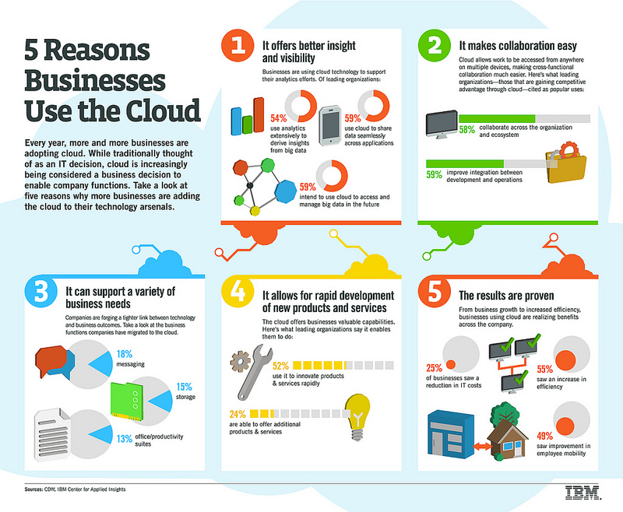
Source: IBM

Slide 21
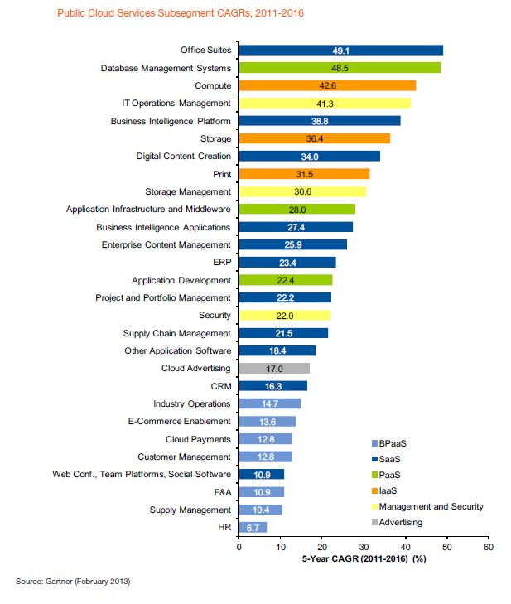
Public Cloud Services Compound Annual Growth Rate (CAGR) 2011 - 2016
Source: forbe

Slide 22
Software as a Service (SaaS)
SaaS is the delivery of an application over the Internet, usually accessed through a browser.
Aka: web-based software, on-demand software or hosted software.
Multitenant Architecture, Easy Customization, Better Access
SaaS Integration Platform (SIP) - 3rd wave in software adoption.
Notes:
http://www.salesforce.com/saas/
The payoff:
SaaS customers have no hardware or software to buy, install, maintain, or update. Access to applications is easy: You just need an Internet connection.
SaaS Characteristics:
A good way to understand the SaaS model is by thinking of a bank, which protects the privacy of each customer while providing service that is reliable and secure—on a massive scale. A bank’s customers all use the same financial systems and technology without worrying about anyone accessing their personal information without authorization.
A “bank” meets the key characteristics of the SaaS model:
Multitenant Architecture
A multitenant architecture, in which all users and applications share a single, common infrastructure and code base that is centrally maintained. Because SaaS vendor clients are all on the same infrastructure and code base, vendors can innovate more quickly and save the valuable development time previously spent on maintaining numerous versions of outdated code.
Easy Customization
The ability for each user to easily customize applications to fit their business processes without affecting the common infrastructure. Because of the way SaaS is architected, these customizations are unique to each company or user and are always preserved through upgrades. That means SaaS providers can make upgrades more often, with less customer risk and much lower adoption cost.
Better Access
Improved access to data from any networked device while making it easier to manage privileges, monitor data use, and ensure everyone sees the same information at the same time.
http://caas.tmcnet.com/topics/web-2/articles/53706-revx-intros-saas-integration-platform.htm
SIP: This is a messaging-based gateway and serves as a local “integrating hub” which connects on and off premise SaaS and Cloud-based services (means a way to integrate SaaS solutions in a federated model).

Slide 23
Benefits of SaaS
Lower entry cost.
No upfront investment in servers.
No software licensing.
No software updates for customers.
Global availability.
High Adoption.
Ease IT pain.
One application to maintain for providers.
Notes:
http://www.saasblogs.com/2007/05/02/saas-101-the-benefits/
White paper: http://wiki.apexdevnet.com/events/whitepaper/registration.php
http://www.amtdirect.com/saas_benefits.php
http://www.salesforce.com/saas/benefits-of-saas/’
Benefits of SaaS
Historically, companies were required to buy, build, and maintain their IT infrastructures despite exponential costs. SaaS gives companies an alternative. Now, they can plug in and subscribe to services built on shared infrastructure via the Internet. The SaaS model has flourished in recent years because of the many benefits it offers to businesses of all sizes and types. Here’s what’s driving customers to take advantage of SaaS solutions:
High Adoption SaaS applications are available from any computer or any device—any time, anywhere. Because most people are familiar with using the Internet to find what they need, SaaS apps tend to have high adoption rates, with a lower learning curve.
Lower Initial Costs SaaS applications are subscription based. No license fees mean lower initial costs. Having the SaaS provider manage the IT infrastructure means lower IT costs for hardware, software, and the people needed to manage it all.
Painless Upgrades Because the SaaS provider manages all updates and upgrades, there are no patches for customers to download or install. The SaaS provider also manages availability, so there’s no need for customers to add hardware, software, or bandwidth as the user base grows.
Seamless Integration SaaS vendors with true multitenant architectures can scale indefinitely to meet customer demand. Many SaaS providers also offer customization capabilities to meet specific needs. Plus, many provide APIs that let you integrate with existing ERP systems or other business productivity systems.

Slide 24







What’s being offered as SaaS?
Billing
CRM (Customer Relation Management)
Collaboration
Content Management
Document Management
ERP (Enterprise Resource Planning)
Financials
Health and Wellness
Personal Productivity
Project Management
Sales
Security
Notes:
So I start to think that I may want to look at what is available if I want to consider a SaaS solution…
A to Z slide that shows just about all companies that have a presence on the Internet have something to offer across various categories.

Slide 25
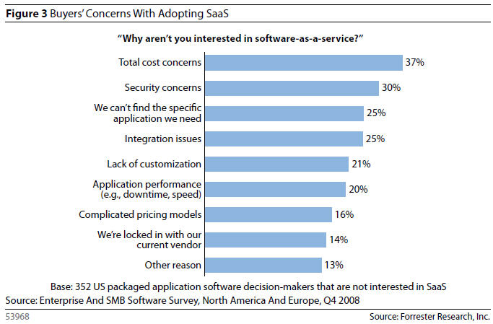
SaaS Adoption Concerns
Notes:
Supports what is also being said about Cloud Adoption in general.

Slide 26
SaaS Implementation Strategy
Select the provider
Sign Contract
Detailed Exit Strategy
Manage Relationship
Contingency Plan
Interoperability
IT’s Role
Executive Support
Align to Company Objectives
Notes:
From an article in InformationWeek, May 2010, p40
Don’t forgo the due diligence in selecting a provider.
How flexible is the contract? Needs do change.
Can you get your data back if you cancel? What is the cost and what proprietary integration steps were taken?
Usage levels dictate costs so monitoring is critical. IT is not generally good at outsourcing: managing both time and communication.
What will you do if the application goes down? One vendor we spoke with wanted a dedicated line.
How will the systems integrate? What middleware or API will be used? Will certain features have to be integrated into calendars and at what speed?
What will IT have to commit in the way of administration and support?
Ensure that leadership is aware of the benefits and risks.
Is the company reducing capital spending or delivery times?

Slide 27
Ways We are Using the Cloud Services
Mash-ups
Effectively mesh with on-site architecture.
Utility API’s
Virtual Servers and Storage, accessed on demand.
Web Service Calls
Google Maps, ADP payroll, U.S. Postal
Managed Services
Exposed to IT and not the users.
Notes:
Mash-ups: Two types, web-browser based or server based. Typically using new Web 2.0 technology with ajax in browser.
Utility API’s: ex: an API supplied by Amazon EC2 to help manage the on-demand resources.
Web Service Calls: web api used to access services via http.
Managed Services: Typically services managed by a provider for efficient operation such as the Internet or Backups.
that are intelligent enough to make use of the services through API’s and other web services.

Slide 28
Summary
Expectation that Cloud Computing will be the wave of the future.
Security remains a concern and an attractive target for hackers.
There remains a need for standards across vendors.
Promise of cost savings along with scalability and availability.
Only time will help with evaluation and acceptance.

